Slide 1
Supervised Learning Methods: Part 2

Slide 2
Supervised Learning Methods: Part 2
We will extend our repository of tools and techniques through some more popular algorithms that have proven to be state of the art for various machine learning problems in the past.

Slide 3
Naive Bayes
Naive Bayes is a category of Bayesian classifiers that aim to predict the probability that a given data point belongs to a particular class.
These methods are based on Bayes’ theorem.
Naive Bayes classifiers have a general assumption1 that the effect of an attribute value on a given class in independent of the values of the other attributes.
This assumption is called class-conditional independence. It simplifies the computations involved and thus considered naive.

Slide 4
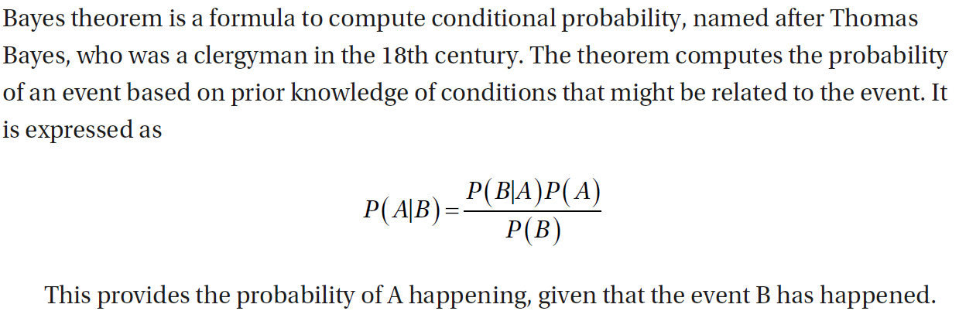
Bayes Theorem

Slide 5
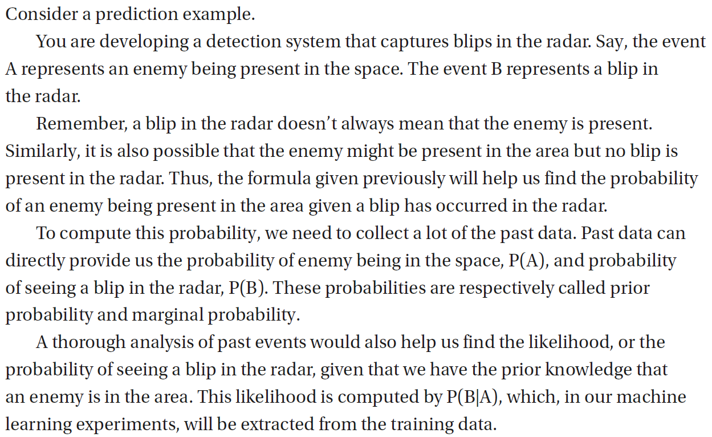

Slide 6
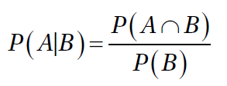
Conditional Probability
The main component of the formula given by Bayes’ theorem is conditional probability.
Conditional probability is a measure of the probability of an event, given that another event (by assumption, presumption, assertion, or evidence) has already occurred.
It is computed from joint probability of A and B.

Slide 7
How Naive Bayes Works
In simple words, during the training phase, naive Bayes attempts to calculate the prior probability for the given class labels.
This is followed by computing the likelihood probability with each attribute for each class.
This information is used to compute the posterior probability using the Bayes formula.
We calculate the posterior probability for the data item belonging to each class and choose the class label with the highest probability.

Slide 8
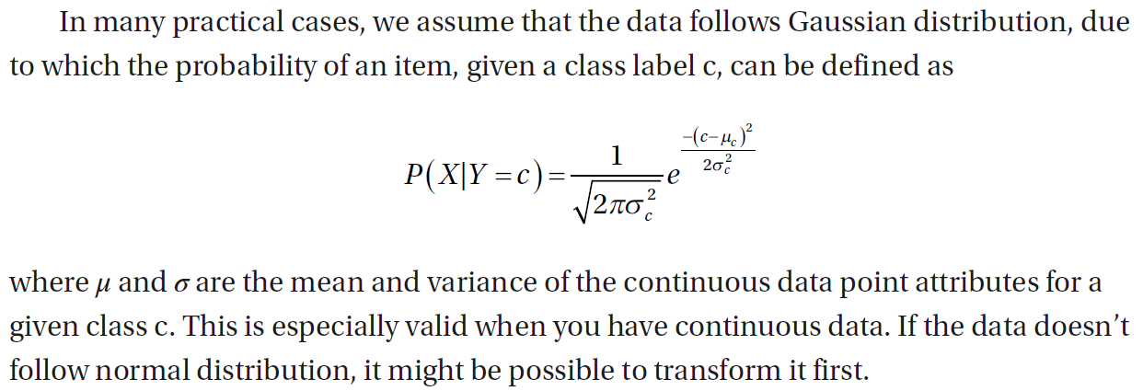

Slide 9
Naive Bayes in Python
For this example, we will load Iris dataset from the available datasets. Because Iris dataset contains continuous variables, we will assume Gaussian distribution and train a Gaussian naive Bayes model.

Slide 10
  from sklearn import datasets
  import matplotlib.pyplot as plt
  iris = datasets.load_iris()
  X = iris.data[:, :] # we can select individual features
  y = iris.target
  from sklearn.model_selection import train_test_split
  X_train, X_test, y_train, y_test = train_test_split(X, y, test_size = 0.25, random_state = 0)

Slide 11
We will now import Gaussian naive Bayes from sklearn and fit it to find the parameters and probabilities.
  from sklearn.naive_bayes import GaussianNB
  clf = GaussianNB()
  clf.fit(X_train, y_train)

Slide 12
You can explore the learned parameters using
  clf.class_prior_ # prior probabilities for the three classes
  clf.var_ # variance of each feature, with respect to each class
  clf.theta_ # mean of each feature, with respect to each class

Slide 13
In the next piece of code, we will retrain the classifier with only the first two columns from the data so that we can visualize the decision boundaries in two dimensions.

Slide 14
As we’ve discussed in the previous section, if we know the prior probabilities and mean and variance of each feature, we can use it to compute the conditional probability P(X| Y = c), which can in turn be used to predict P(Y=c | X) using Bayes’ theorem.
Prediction method follows the same conventions:
  y_pred = clf.predict(X_test)
  from sklearn.metrics import confusion_matrix
  cm = confusion_matrix(y_test, y_pred)
  print(cm)

Slide 15
In the next piece of code, we will retrain the classifier with only the first two columns from the data so that we can visualize the decision boundaries in two dimensions.
  from matplotlib.colors import ListedColormap
  import numpy as np
  clf = GaussianNB()
  clf.fit(X_train[:,:2], y_train)

Slide 16
Here, we trained a new model with only the first two columns of X_train. This will give us a clearer view of what the classifier is learning.
  x_set, y_set = X_train[:,:2], y_train
  X1, X2 = np.meshgrid(np.arange(start = x_set[:, 0].min() - 1, stop =x_set[:, 0].max() + 1, step = 0.01),np.arange(start = x_set[:, 1].min() - 1, stop =x_set[:, 1].max() + 1, step = 0.01))

Slide 17
  plt.contourf(X1, X2, clf.predict(np.array([X1.ravel(), X2.ravel()]).T).reshape(X1.shape),alpha = 0.75, cmap = ListedColormap(('purple', 'green','yellow')))
  plt.xlim(X1.min(), X1.max())
  plt.ylim(X2.min(), X2.max())
  for i, j in enumerate(np.unique(y_set)):
  plt.scatter(x_set[y_set == j, 0], x_set[y_set == j, 1],color = ListedColormap(('purple', 'green', 'yellow'))(i),label = j)
  plt.legend()
  plt.show()

Slide 18
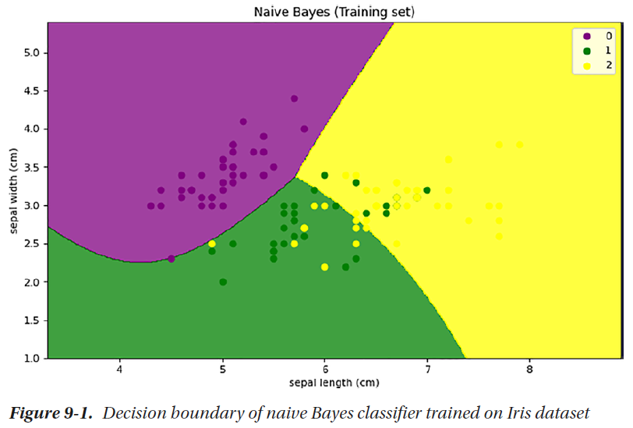

Slide 19
Support Vector Machines
Support Vector Machines (SVM) is a highly efficient and effective method that has been proven to be a state of the art in various scenarios.
Unlike other classification methods that attempt to find a decision boundary that minimizes the error between two classes, Support Vector Machines try to find a decision boundary that maximizes the margin between the two classes called a maximum marginal hyperplane.

Slide 20
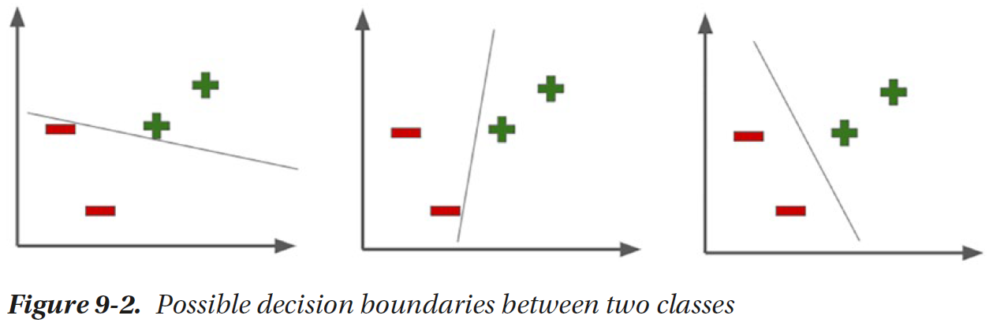

Slide 21
The margin around the decision boundary depends on the points that generate the maximum width of the margin and thus the difference between the closest training data points.
These points are called support vectors, and thus the name of the method. The other points in the training dataset do not contribute to the model.
While learning, the goal is to maximize the width of the margin and minimize the margin errors, that is, the points that are on the wrong side of the margin.

Slide 22
How SVM Works
The hyperplane that divides the data points has equal margin on the two sides parallel to the hyperplane.
In two dimensions, hyperplane is a straight line that divides the data into positive class and negative class. Figure 9-3 shows the margins on the two sides of the line running parallel and equidistant to the hyperplane.

Slide 23
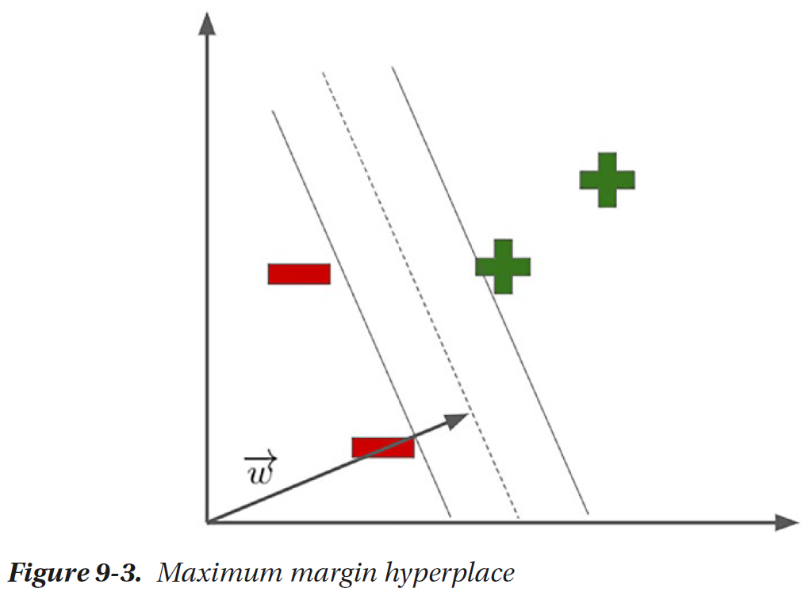

Slide 24
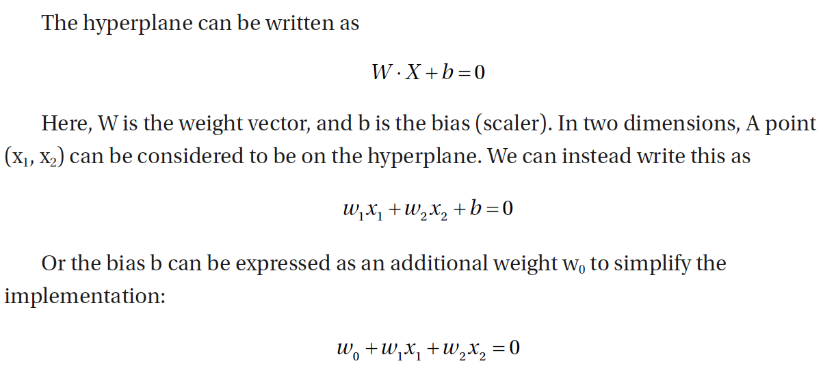

Slide 25
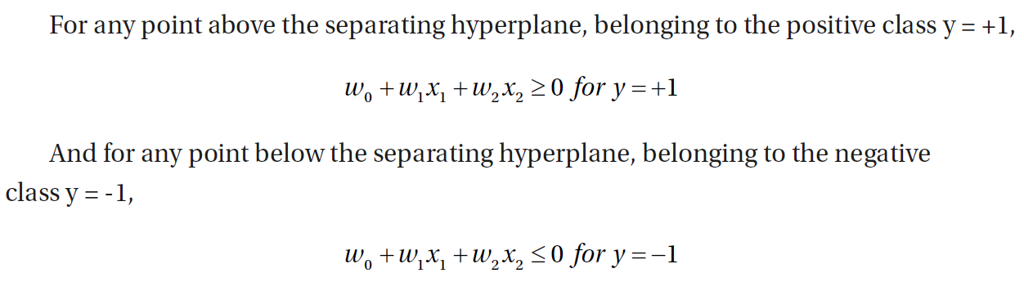

Slide 26
The aim of the learning algorithm is to find the support vectors and the maximum margin hyperplane, that is, the decision boundary that maximizes this distance.

Slide 27
Nonlinear Classification
As SVM can create a linear decision boundary, it is important to understand how they can be customized to find decision boundaries in nonlinearly separable data.
Using a simple transformation, we add one more dimension to the data – and as shown in Figure 9-4, it is possible to find a hyperplane (now, a line) that can easily separate the two classes.

Slide 28
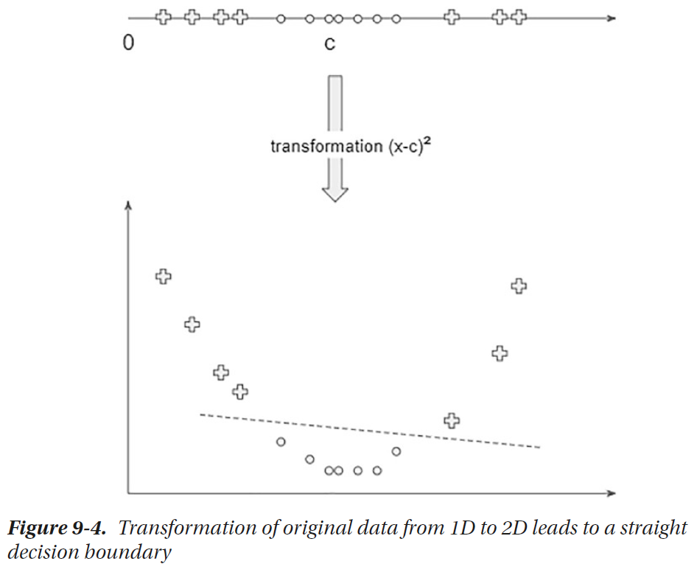

Slide 29
So the idea is first transform the data to a higher dimension using a nonlinear transformation. Then we can find a hyperplane in the new dimensions that can easily separate the two classes.
At this point, we can use the same method for SVM as mentioned in the previous section.
However, it is inefficient to apply plenty of such transformations, followed by dot products. This is solved using a method called the Kernel Trick.

Slide 30
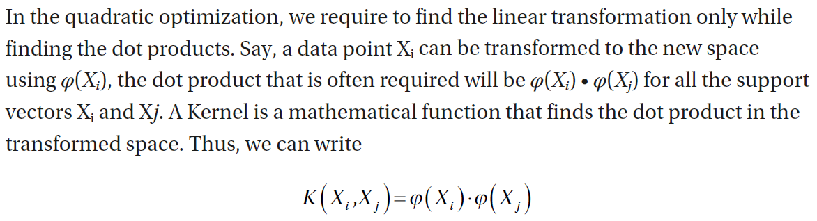
Kernel Trick in SVM

Slide 31
So during the training process, if there’s any situation where we first need the transformation, followed by dot products, we can replace that with the Kernel function.
The computations happen in the lower dimensions, and the decision boundary can be seen as being created in the higher dimensions. This is known as Kernel Trick.

Slide 32
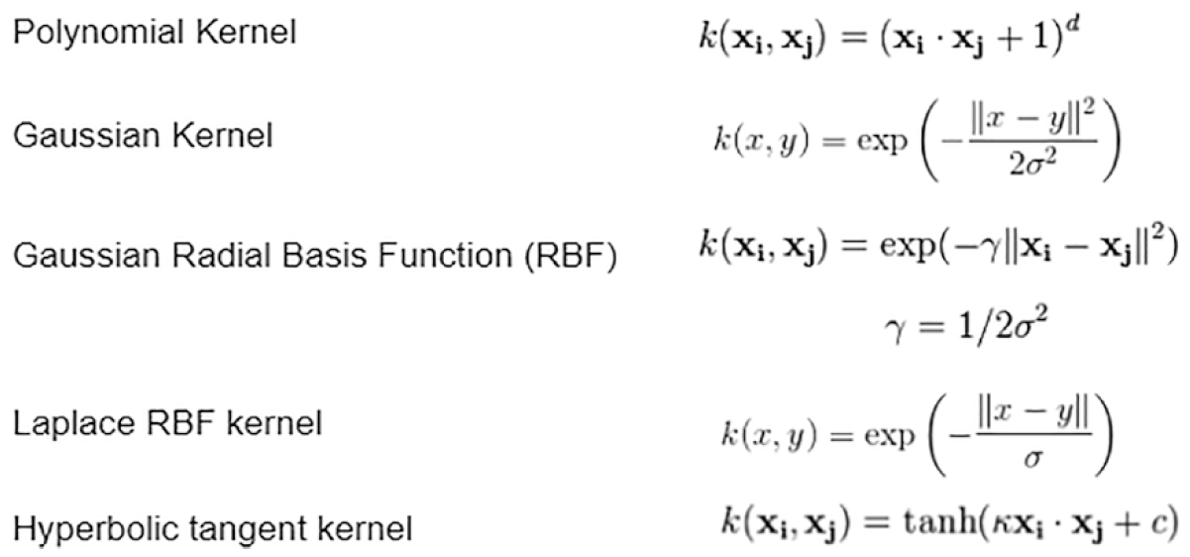
The most commonly used Kernels are given here:

Slide 33
In SVM implementations, you can experiment with the different possible kernels through the hyperparameters, which you will have to tune in the experimental process while also keeping a note of the additional hyperparameters that your Kernel of choice depends on.

Slide 34
Support Vector Machines in Python
We will experiment with a simple dataset and visualize the decision boundaries with different kernels of SVM implementation.
Scikit-learn provides Support Vector Machines under sklearn.svm package.
SVM is a class of algorithms that can be used in regression problems, often written as SVR (Support Vector Regressors), and classification problems, written as SVC (Support Vector Classifiers).

Slide 35
sklearn.svm.LinearSVC is implemented using liblinear and offers a different set of penalties and loss functions compared to sklearn.svm.SVC, which is based on libsvm.
For large datasets, LinearSVC has been recommended instead of SVC. We will compare LinearSVC and SVC with different types of kernels in the following examples.
Choosing the right kernel requires experimentation through cross validation–based model selection.
Linear and RBF have proven to be fast and highly effective in a lot of common use cases.

Slide 36
We will continue this example with Iris dataset while taking first two columns only: first, to be able to visualize well and, second, to make decision boundaries only based on limited parameters.
  import numpy as np
  import pandas as pd
  from sklearn.datasets import load_iris
  iris = load_iris()
  df = pd.DataFrame(iris.data, columns=iris.feature_names)
  df['species'] = pd.Categorical.from_codes(iris.target, iris.target_names)
  df['target'] = iris.target
  X = df.iloc[:,:2]
  y = df.iloc[:,5]

Slide 37
We can train an SVM with default hyperparameters as follows:
  from sklearn import svm, datasets
  svc = svm.SVC(kernel='linear').fit(X, y)
SVC can accept these kernels: linear, poly, rbf, sigmoid, and precomputed. The default value is rbf, or Radial Basis Function.
Remember, you might need to supply additional hyperparameters depending on your kernel of choice.
For example, if you decide to build a Support Vector Classifier with polynomial kernel, you may add another hyperparameter for degree. If you do not provide the additional hyperparameter, the default value will be taken, which is 3.

Slide 38
Once the model is trained, you can look at the support vectors – which are representatives of the dataset boundaries.
  support_vector_indices = svc.support_
  print(len(support_vector_indices))
  support_vectors_per_class = svc.n_support_
  print(support_vectors_per_class)
These properties give the count of support vectors. In the second output, you can see that there are only two support vectors for the first class; that is, Iris Setosa, which we’ve

Slide 39
You can find the actual points acting as support vectors:
  support_vectors = svc.support_vectors_
support_vectors object will contain every training data point that is being used in constructing the decision boundaries that maximizes the hyperplane.

Slide 40
You can visualize them to get a clearer understanding of what’s being learned. The following code would lead to results similar to Figure 9-5.
  xx,yy = np.meshgrid( np.arange(3, 9, 0.1), np.arange(1,6, 0.1) )
  Z = svc.predict(np.c_[xx.ravel(), yy.ravel()])
  Z = Z.reshape(xx.shape)
  import matplotlib.pyplot as plt
  plt.scatter(X.iloc[:,0], X.iloc[:,1])
  plt.contourf(xx, yy, Z, cmap=plt.cm.coolwarm, alpha=0.4)
  plt.scatter(support_vectors[:,0], support_vectors[:,1], color='red')
  plt.title('Support Vectors Visualized')
  plt.xlabel('X1')
  plt.ylabel('X2')
  plt.show()

Slide 41
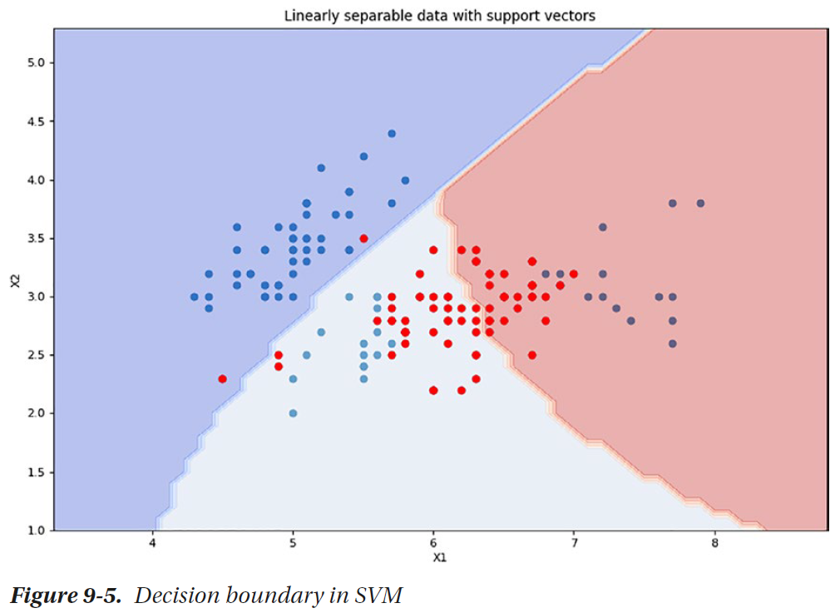

Slide 42
Let’s construct some more Support Vector Classifiers for the same dataset and try to compare them.
In this example, we will take the first two classes (first 100 rows of Iris dataset) so that the boundaries will be clearer to visualize.
This will allow us to compare the different implementations of SVCs.

Slide 43
  import numpy as np
  import pandas as pd
  from sklearn.datasets import load_iris
  iris = load_iris()
  df = pd.DataFrame(iris.data, columns=iris.feature_names)
  df['species'] = pd.Categorical.from_codes(iris.target, iris.target_names)
  df['target'] = iris.target
  X = df.iloc[:100,:2]
  y = df.iloc[:100,5]

Slide 44
We will create four objects, for linear, rbf, polynomial kernels, and one for LinearSVC implementation.
  from sklearn import svm
  C = 1.0 # SVM regularization parameter
  svc = svm.SVC(kernel='linear', C=C).fit(X, y)
  rbf_svc = svm.SVC(kernel='rbf', gamma=0.7, C=C).fit(X, y)
  poly_svc = svm.SVC(kernel='poly', degree=3, C=C).fit(X, y)
  lin_svc = svm.LinearSVC(C=C).fit(X, y)

Slide 45
In these lines, we have initialized and trained three SVC-based classifiers with kernels, namely, linear, rbf, and polynomial.
We have another classifier using LinearSVC, which is a slightly different implementation.
  titles = ['SVC with linear kernel','LinearSVC (linear kernel)','SVC with RBF kernel','SVC with polynomial (degree 3) kernel']
  xx,yy = np.meshgrid( np.arange(3, 9, 0.1), np.arange(1,6, 0.1) )
  import matplotlib.pyplot as plt
  plt.figure(figsize=(20,10))

Slide 46
  for i, clf in enumerate((svc, lin_svc, rbf_svc, poly_svc)):
  plt.subplot(2, 2, i + 1)
  plt.subplots_adjust(wspace=0.4, hspace=0.4)
  Z = clf.predict(np.c_[xx.ravel(), yy.ravel()])
  # Put the result into a color plot
  Z = Z.reshape(xx.shape)
  plt.contourf(xx, yy, Z, cmap=plt.cm.coolwarm, alpha=0.4)
  # Plot also the training points
  plt.scatter(X.iloc[:, 0], X.iloc[:, 1], c=y, cmap=plt.cm.coolwarm)
  plt.xlabel('Sepal length')
  plt.ylabel('Sepal width')
  plt.xlim(xx.min(), xx.max())
  plt.ylim(yy.min(), yy.max())
  plt.xticks(())
  plt.yticks(())
  plt.title(titles[i])
  plt.show()

Slide 47
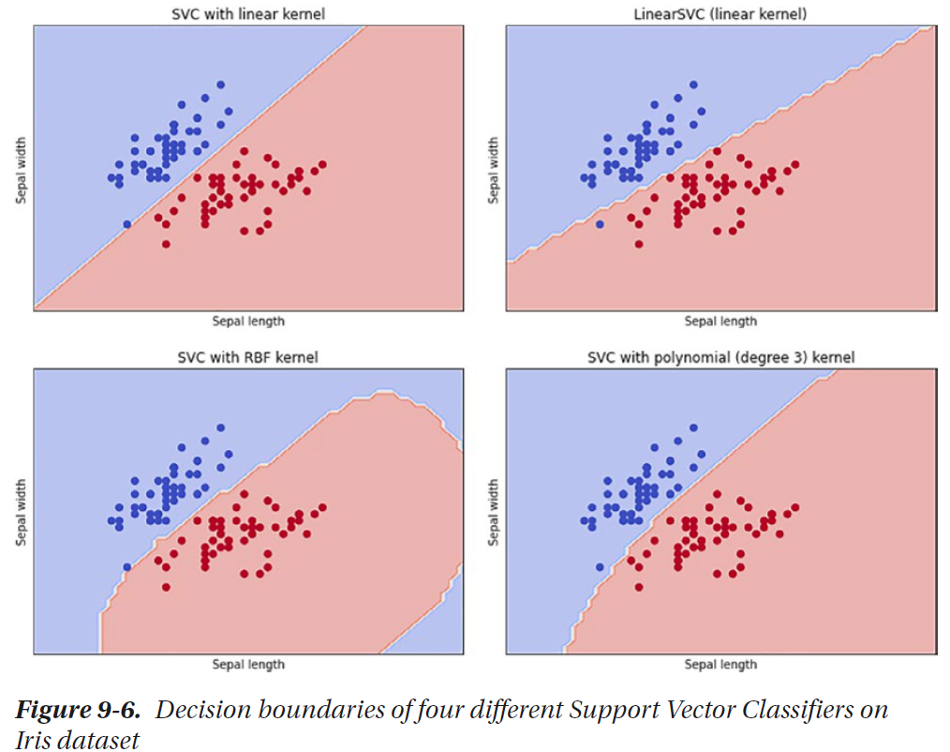

Slide 48
SVMs are highly effective in high dimension spaces.
They are also very memory efficient due to the notion of support vectors, which is a relatively small subset of the training points.
Kernel functions can help you make the decision boundary more flexible and robust.

Slide 49
Summary
This chapter has presented advanced supervised learning techniques that have proven to be state of the art in various scenarios.
In the next chapter, we will discuss another method that combines the power of multiple less accurate models to create an eventual robust model.

